Slide 1
DESIGN AND IMPLEMENTATION OF A WEB-BASED SMART RFID STUDENT ID CARD READER

Slide 2
Department of computer Engineering (esut)
Presented by: orji Michael chukwuebuka
Student registration number: 2017030180311
Supervisor: Dr. t. chiagunye

Slide 3
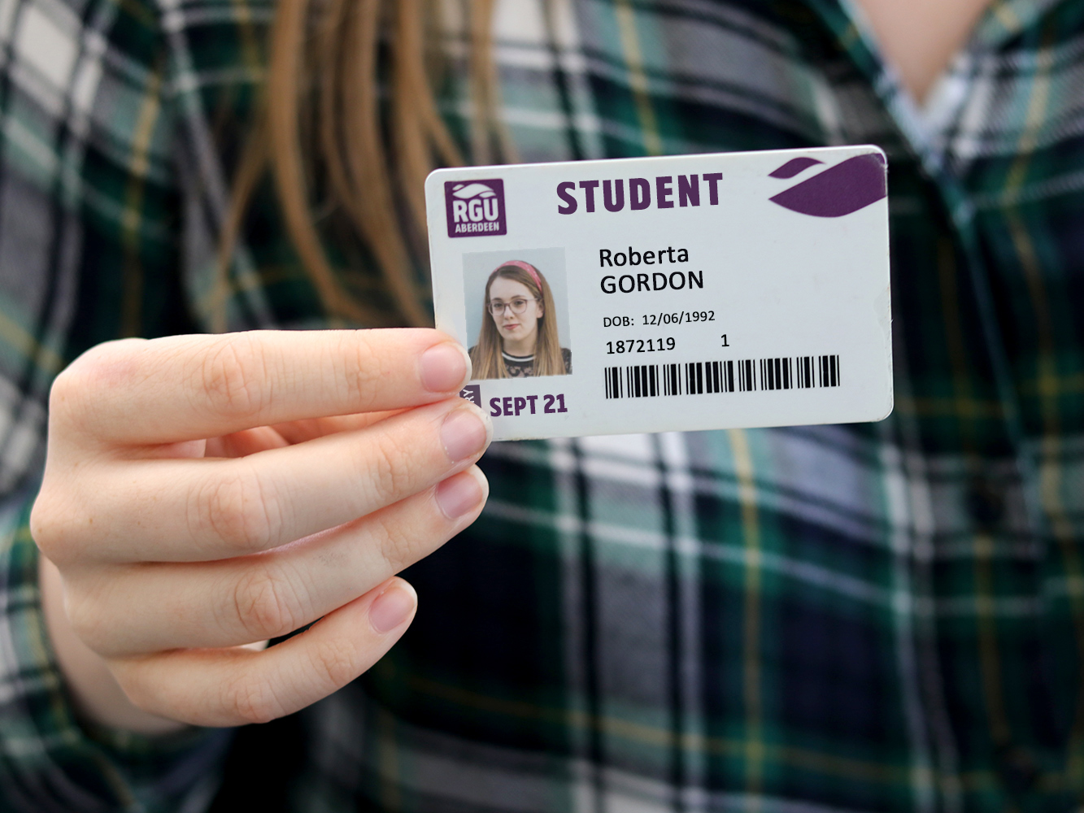
Introduction
The product is an IoT device and website that closes the gap between online servers and the people. It offers a unique way to get information about a particular student without specifically needing a computer, phone or printed document; through their ID cards.

Slide 4

Aim and objectives
1) Couple and program a small hardware device that connects to the internet through Wi-Fi using the NodeMCU Microcontroller and the C programming language

Slide 5
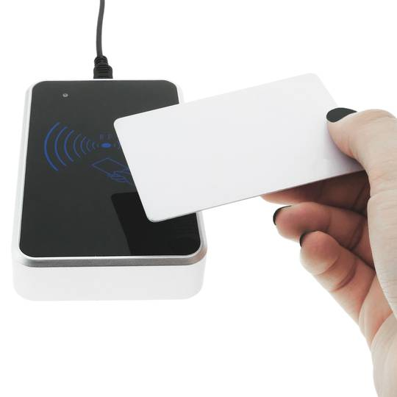
Aim and objectives
2) Couple a small hardware device that can read RFID tags using the NodeMCU Microcontroller and RC522 RFID Card Reader

Slide 6
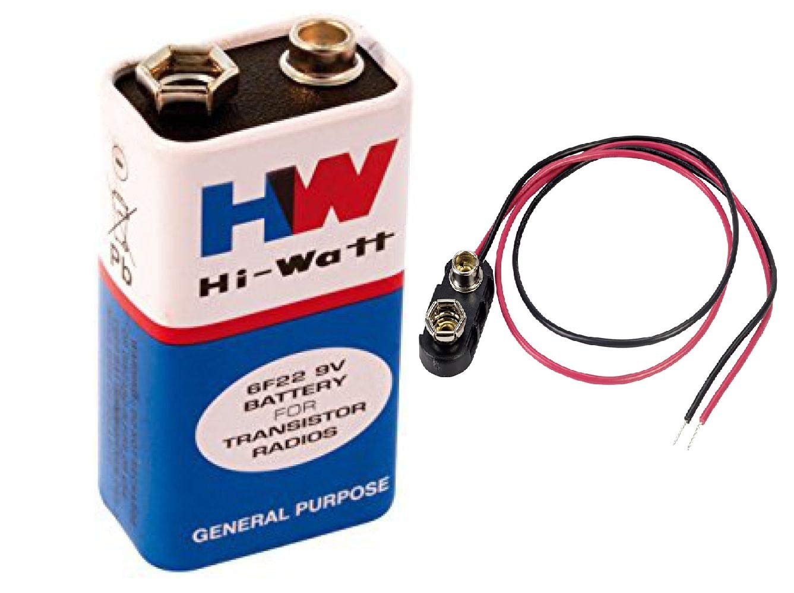
Aim and objectives
3) Make sure the device runs on minimal electricity and uses a 9V Battery

Slide 7
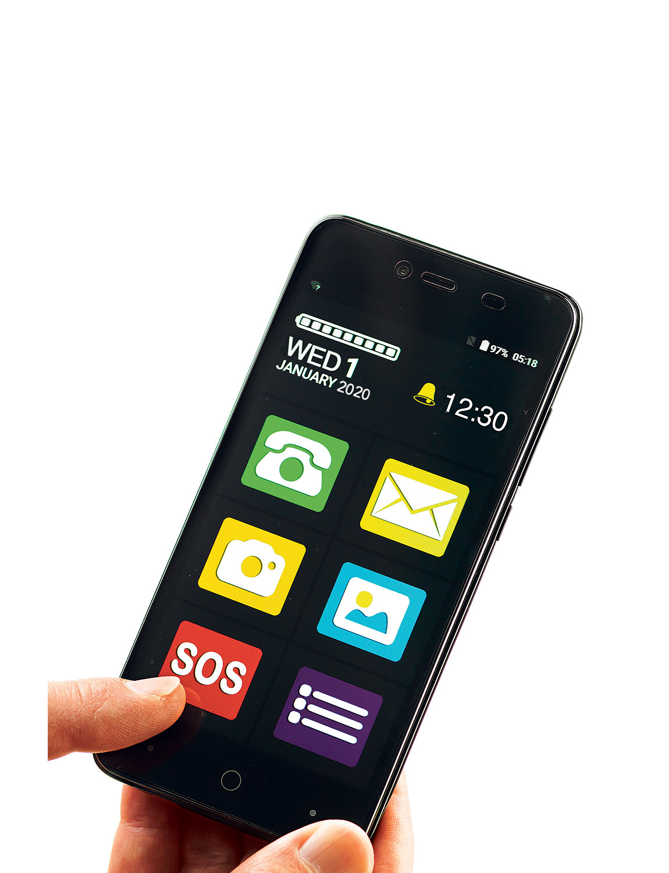
Aim and objectives
4) Ensure the device is easy to use and understand

Slide 8
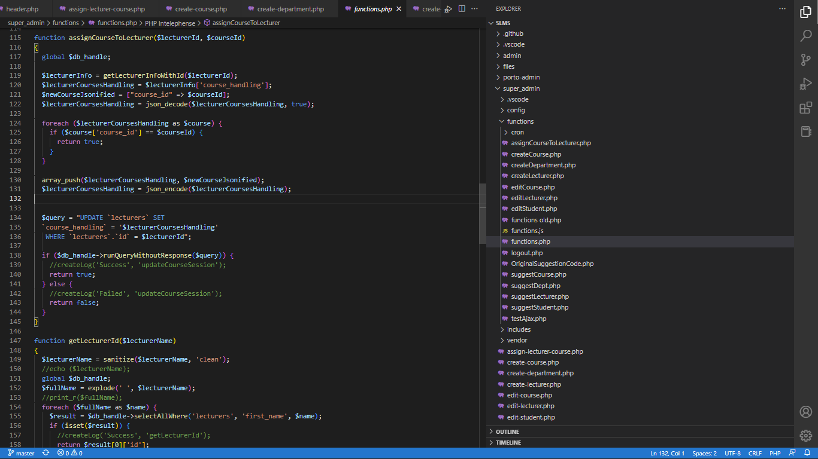
Aim and objectives
5) Write code for a website that displays the required data in an easy to read format

Slide 9

Aim and objectives
6) Host aforementioned website online on an Apache web server

Slide 10
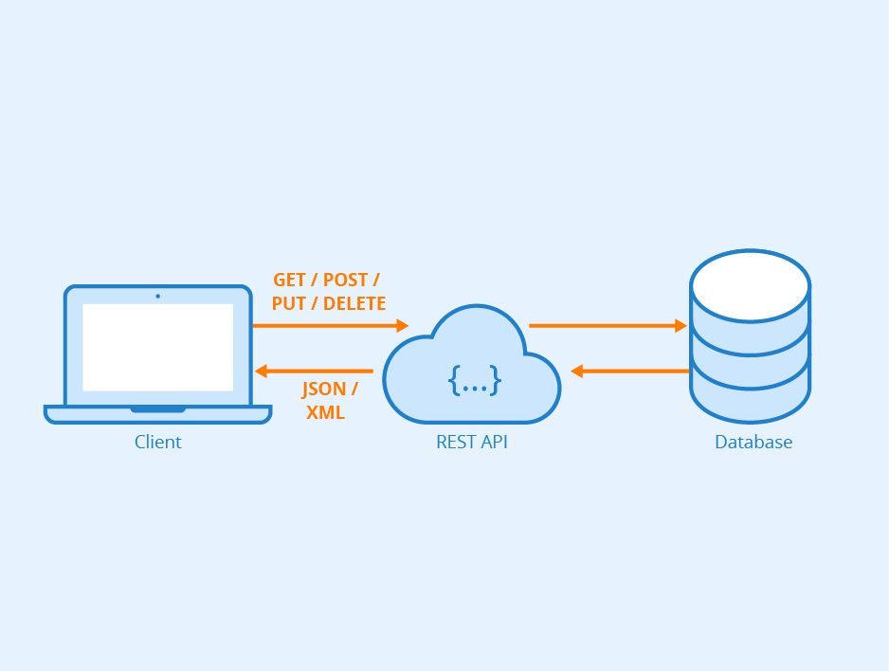
Aim and objectives
7) Ensure the hardware device communicates effectively and efficiently with the web server using API’s

Slide 11
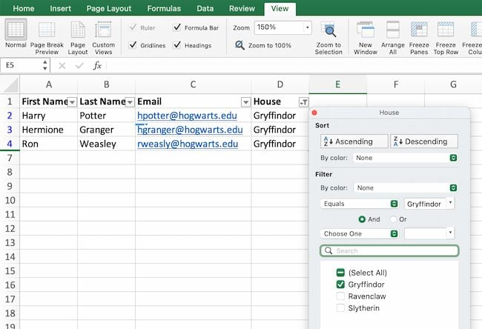
Aim and objectives
8) Write code on web server that lets its users download summarized data in either Excel or CSV format

Slide 12

Aim and objectives
9) Test each feature and ensure that everything is fully functional

Slide 13
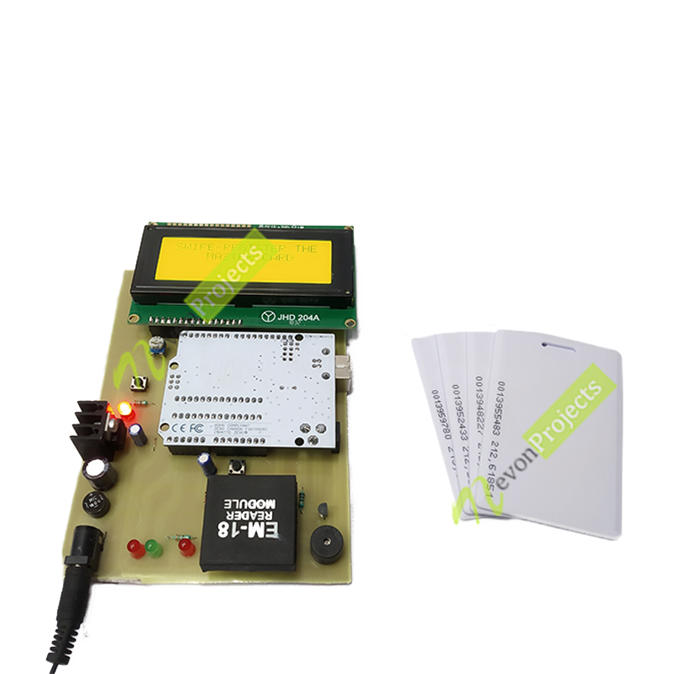
Summary of problems of existing systems
Rigidity
Limited Storage Capacity
Lack of Application of the Internet
Lack of Data Persistence
Inflexibility

Slide 14
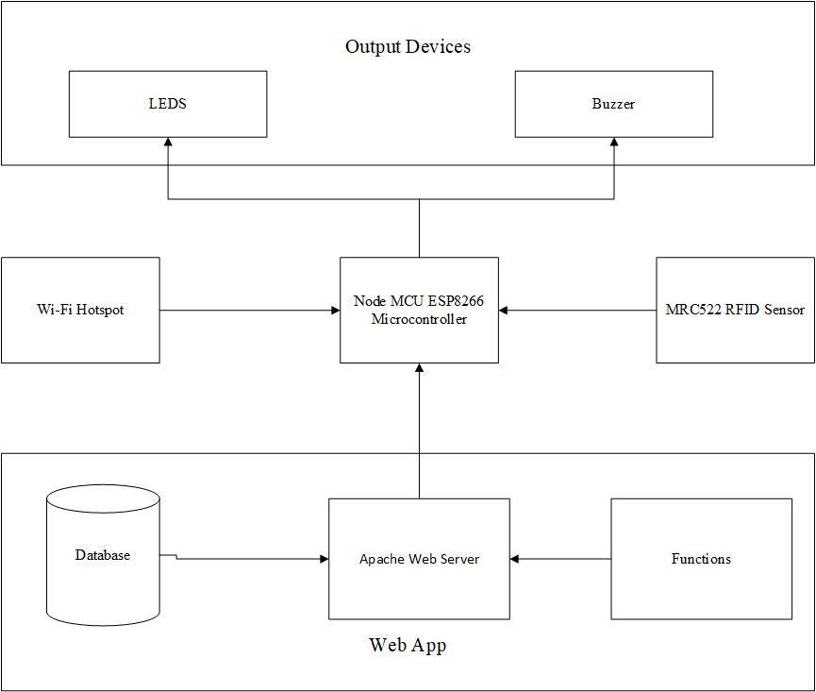
Block diagram of the proposed system
Node MCU ESP8266 Microcontroller
MRC522 RFID Sensor
Output Devices
Web App

Slide 15
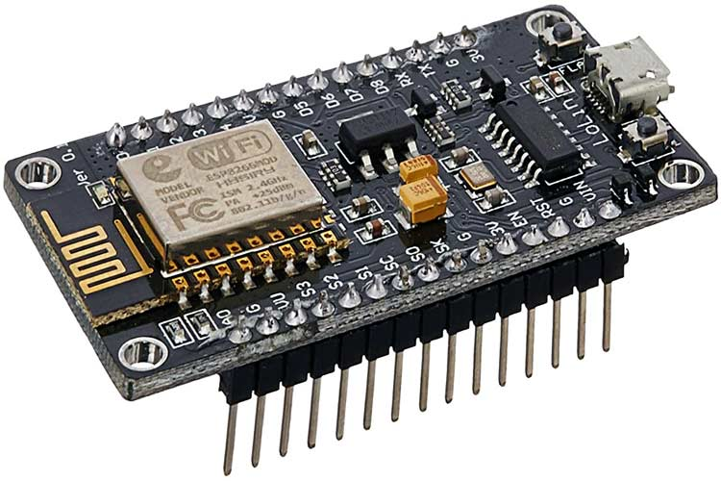
Node MCU ESP8266 Microcontroller
The NodeMCU is a low-cost open source IoT platform. ESP8266 is a highly integrated chip designed for the needs of a new connected world. It offers a complete and self-contained Wi-Fi networking solution, allowing it to either host the application or to offload all Wi-Fi networking functions from another application processor.

Slide 16
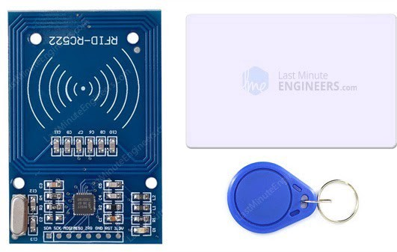
MRC522 RFID Sensor
Radio-frequency identification (RFID) uses electromagnetic fields to automatically identify and track tags attached to objects. The MRC522 sensor is a hardware IC that reads info from a tag that is within readable range of 10cm

Slide 17

Output Devices
This is made up of 4 LEDs and a Buzzer.
Yellow LED: This displays info about Wi-Fi connectivity. When not connected, it blinks. Once connected, it stays on.
Blue LED: This comes on whenever an RFID tag is in readable range and stays on while the request is being processed.
Red LED: Comes on shortly whenever a card request returns a negative response.
Green LED: Comes on shortly whenever a card request returns a positive response
Buzzer: Makes a brief noise when a card request returns a positive response. Works hand in hand with green LED.

Slide 18
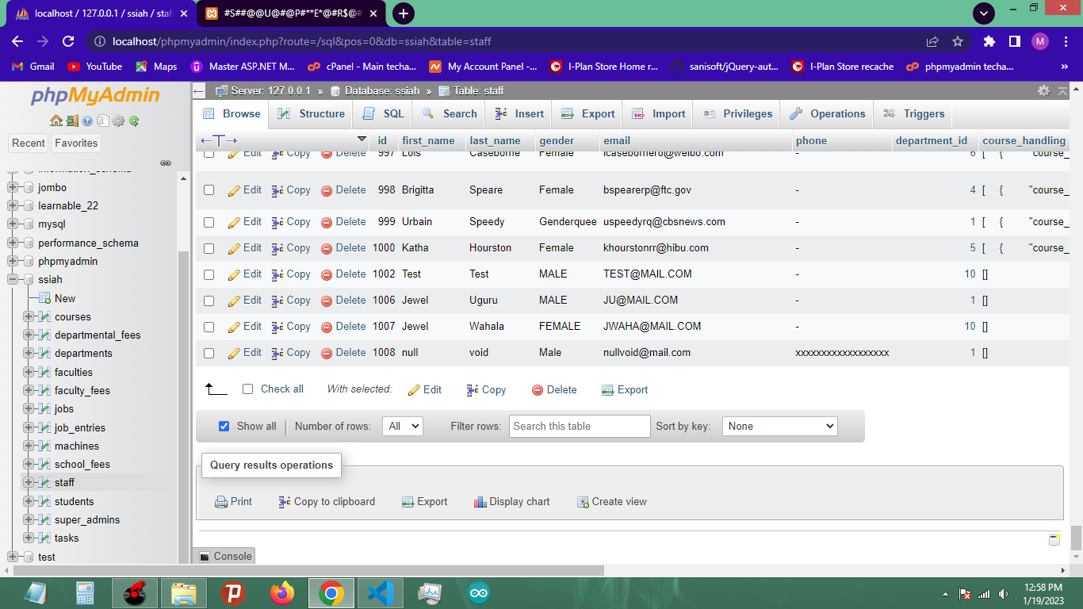
Web App
This is a website hosted on an Apache web server. Built with HTML, CSS, JavaScript, PHP and MySQL.

Slide 19
Smart student id card reader (s.s.i.r)
This is a portable hardware device that scans student ID cards, sends their details to a web server and returns a true or false value. It runs on a 9v battery.

Slide 20
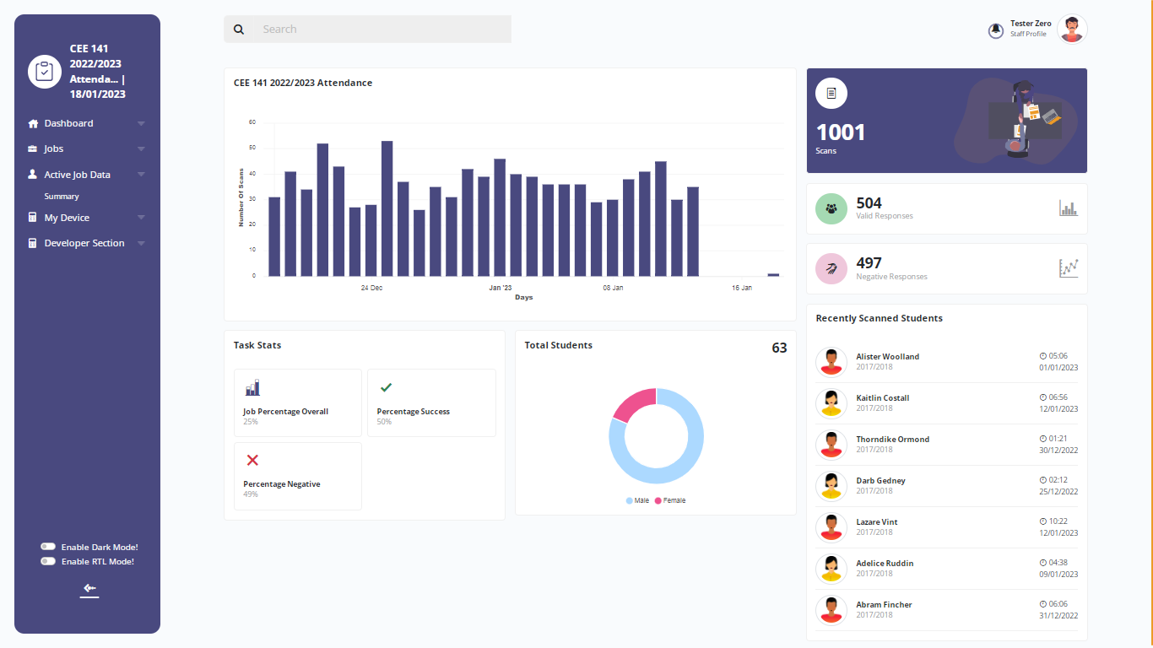
School student id card activity hub (s.s.i.a.h)
This is an Admin dashboard based site that controls the data the hardware device works with. All data sent by the device is processed, controlled and stored by the site. It also contains the database that holds information about the students and lecturers. It is also the avenue through which lecturers control the hardware device and give it its instructions.

Slide 21

conclusion
This project will make the lives of students and staff alike easier, by: reducing manual tasks and carrying around of hardcopy evidence for students; It will save the space used by librarians and admin officers for storing documents; It will reduce the carbon footprint created through the burning of unneeded documents; It will also boost data analysis by offering huge insights into the behavior and activities of students in and around the school

Slide 22
THANK YOU!

